Slide 1




System Analysis and Design
Lecture 1
Presented by: DR.ASMAA MOHAMED

Slide 2
Grades
Assessment | Grade | Description
Final | 40 | ---------------
Midterm | 20 | ---------------
Quizzes | 20 | Two Quizzes
Assignments | 10 | Assignments uploaded in Moodle with discussion
Project | 10 | Final project with discussion
Total = 100

Slide 3

Overall Course Objectives
The course provides Fundamentals of software system analysis and information system development.
Software project selection and management.
Software requirements determination.
Process modeling and use case analysis.
Data modeling and architecture design.
User interface design techniques.

Slide 4

Introduction
An information system (IS) is a coordinated set of components that collects, processes, stores, and distributes data to support decision-making, coordination, and control within an organization.
Examples:
Banking systems for managing accounts and transactions.
Hospital systems for patient records and scheduling.
Inventory management systems in companies.

Slide 5

System Analysis and System Design
System Analysis and System Design are two stages of the software development life cycle.
System Analysis is a process of collecting and analyzing the requirements of the system.
System Design is a process of creating a design for the system to meet the requirements.

Slide 6

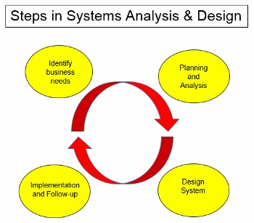
The systems development life cycle (SDLC)
The systems development life cycle (SDLC) is the process of determining how an information system (IS) can support business needs, designing the system, building it, and delivering it to users.

Slide 7
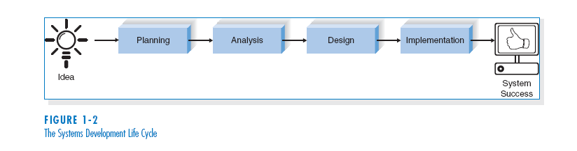
The systems development life cycle (SDLC)
The SDLC is composed of four fundamental phases:
  Planning
  Analysis
  Design
  Implementation
Each of the phases is composed of steps, which rely on techniques that produce deliverables (specific documents that explain various elements of the system).

Slide 8
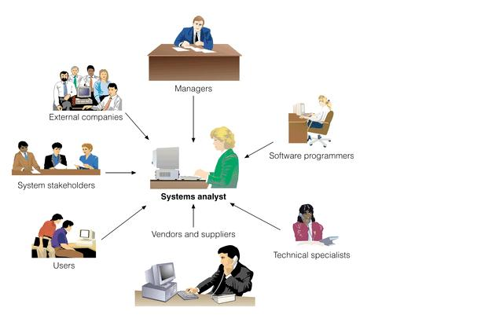
Systems Analyst
The key person in the SDLC is the systems analyst, who analyzes the business situation, identifies the opportunities for improvements, and designs an IS to implement the improvements.

Slide 9
Systems Analyst
Systems analyst is a key role in information system (IS) development projects.
Systems analyst works closely with the project team to ensure the system is developed effectively.
Systems analyst applies technology to solve business problems.
Systems analyst acts as a change agent: identifies needed improvements, designs systems for change, and trains/motivates users.

Slide 10
Systems Analyst Skills
Technical – Must understand the technical environment, technical foundation, and technical solution.
Business – Must understand how IT can be applied to business situations.
Analytical – Must be problem solvers.
Interpersonal – Need to communicate effectively.
Management – Need to manage people and to manage pressure and risks.
Ethical - Must deal fairly, honestly, and ethically with other project members, managers, and systems users.

Slide 11
THANK YOU

